Slide 1
Political Corporate Social Responsibility
How Externalities Influence Market Behavior Looking at Experimental Double Auction Markets to Inform Regulators when Designing Markets

Slide 2

Agenda
1
INTRO
2
RESEARCH QUESTION & HYPOTHESES
3
ANALYSIS
4
SUMMARY & POLICY RECOMMENDATIONS

Slide 3
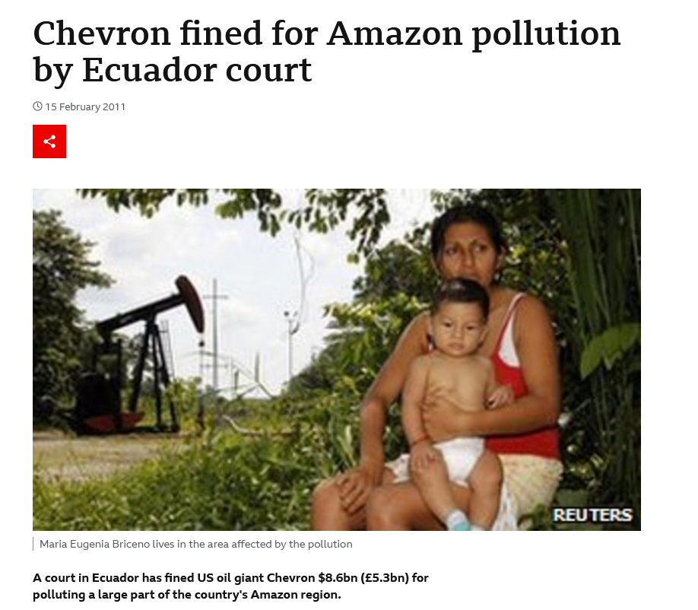
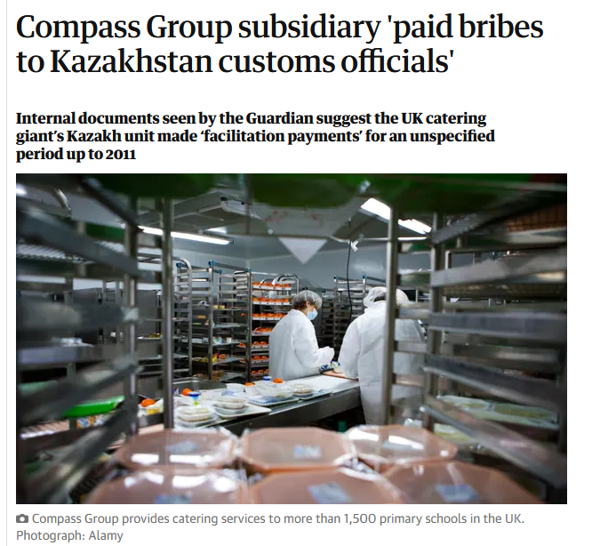
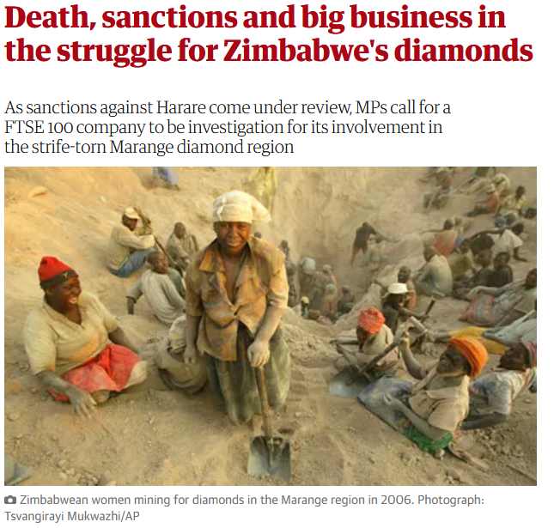
CSR – A Salient Issue
1
POLITICAL CORPORATE SOCIAL RESPONSIBILITY
INTRO
Environmental pollution by oil giant and insufficient clean-up efforts – Chevron (Texaco) in Ecuador (BBC, 2011)
Multinational catering corporation entangled in bribery scheme in Kazakhstan (The Guardian, 2015)
Transnational companies implied in trade with conflict resources (The Guardian, 2013)

Slide 4
What is CSR?
1
POLITICAL CORPORATE SOCIAL RESPONSIBILITY
INTRO
Corporate Social Responsilibity
How is it applied by corporations?
Not-for-profit vs strategic (Kitzmueller & Shimshack, 2012; Baron, 2001)
What is the motivation behind its application?
Delegated philanthropy vs. insider-intiated corporate philanthropy (Benabou & Tirole, 2010)
How is the resulting corporate behavior perceived by the public?
Effect undesirability, corporate culpability, level of complicity (Lange & Washburn, 2012)
Political Corporate Social Responsibility
Where CSR has a political impact or where politics has an impact on CSR (Frynas & Stephens, 2015)
Political Corporate Activity
Political actions taken by corporations to further corporate goals (Lawton et al., 2015; Hillman & Hitt, 1999)
CSR concerns can be operationalized as market externalities
Externalities as byproducts of trading behavior

Slide 5
Goal of the Paper
2
POLITICAL CORPORATE SOCIAL RESPONSIBILITY
RESEARCH QUESTION & HYPOTHESES
1
How do externalities influence market behavior looking at experimental double auction markets?
1.1
How can the results of the experiment help inform regulators when designing markets?
Market Indicators
Macro level
Micro level
Efficiency
Price volatility
Price levels
(Relative) aggressiveness

Slide 6
Expected Results
2
POLITICAL CORPORATE SOCIAL RESPONSIBILITY
RESEARCH QUESTION AND HYPOTHESES
Macro level
Micro level
Efficiency
Price volatility
Price levels
Aggressiveness
1a) Market efficiency in the negative externality market is lower than in the control market. 1b) The positive externality market does not suffer from decreased market efficiency compared to the control market.
2) Price volatility in treatment markets is higher compared to the control market.
3a) Price levels in the positive externality market are higher compared to the control market. 3b) Price levels in the negative externality market are lower compared to the control market.
4) Aggressiveness in the treatment markets is lower compared to the control market.

Slide 7
Macro Level Results*** – Trading Volume
3
POLITICAL CORPORATE SOCIAL RESPONSIBILITY
ANALYSIS
Treatment | Observations* | Mean | Median | Std. | Direction | P-value**
Control | 50 | 81.60% | 80.00% | 15.44% | - | -
Neg. Externalities | 50 | 88.09% | 85.71% | 9.91% | Greater than | 0.01
Pos. Externalities | 60 | 79.66% | 77.50% | 15.61% | Less than | 0.26
* Game treatment pairings ** Does the distribution significantly differ from the control group (depending on whether mean/median is higher or lower than the control group)?
*** Link to public GitHub Repo with Code and Data: https://github.com/brhyner/MA22-externalities-markets

Slide 8
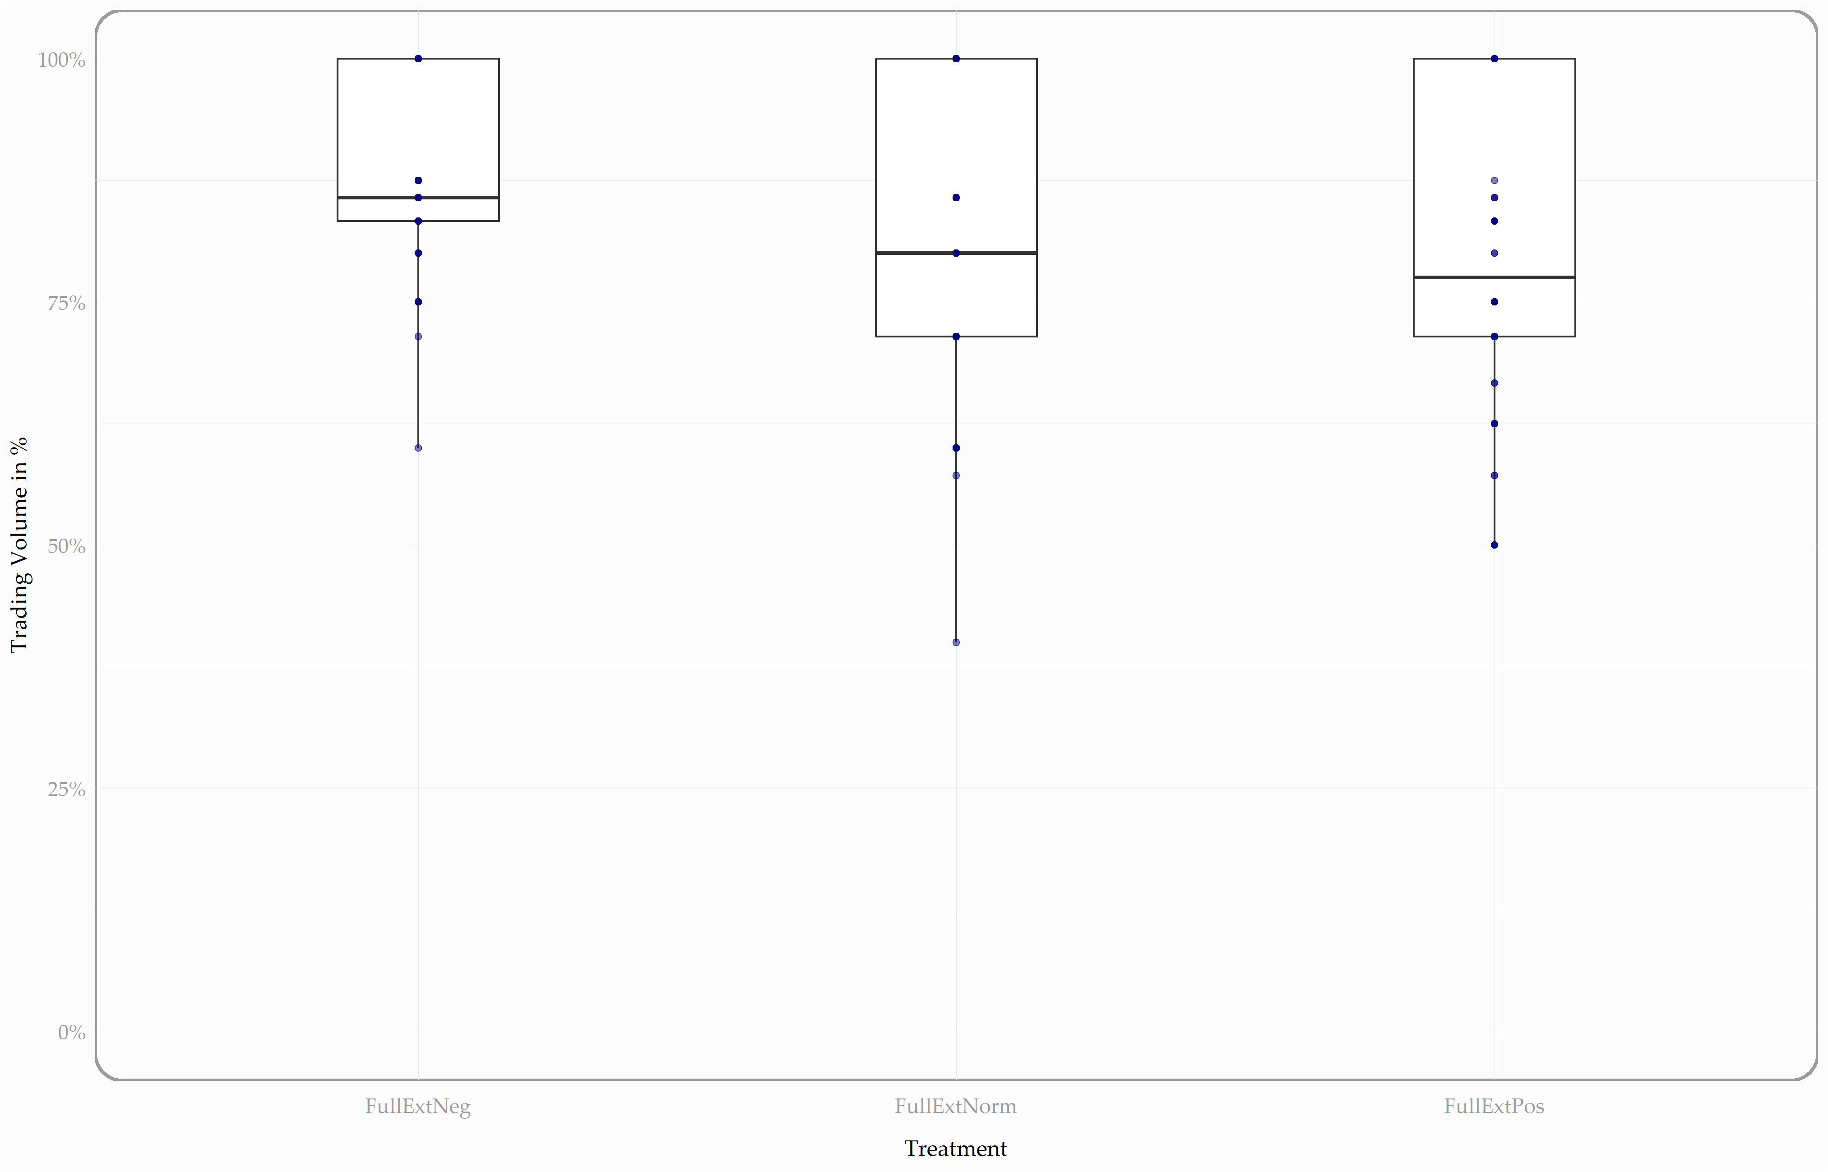

Slide 9
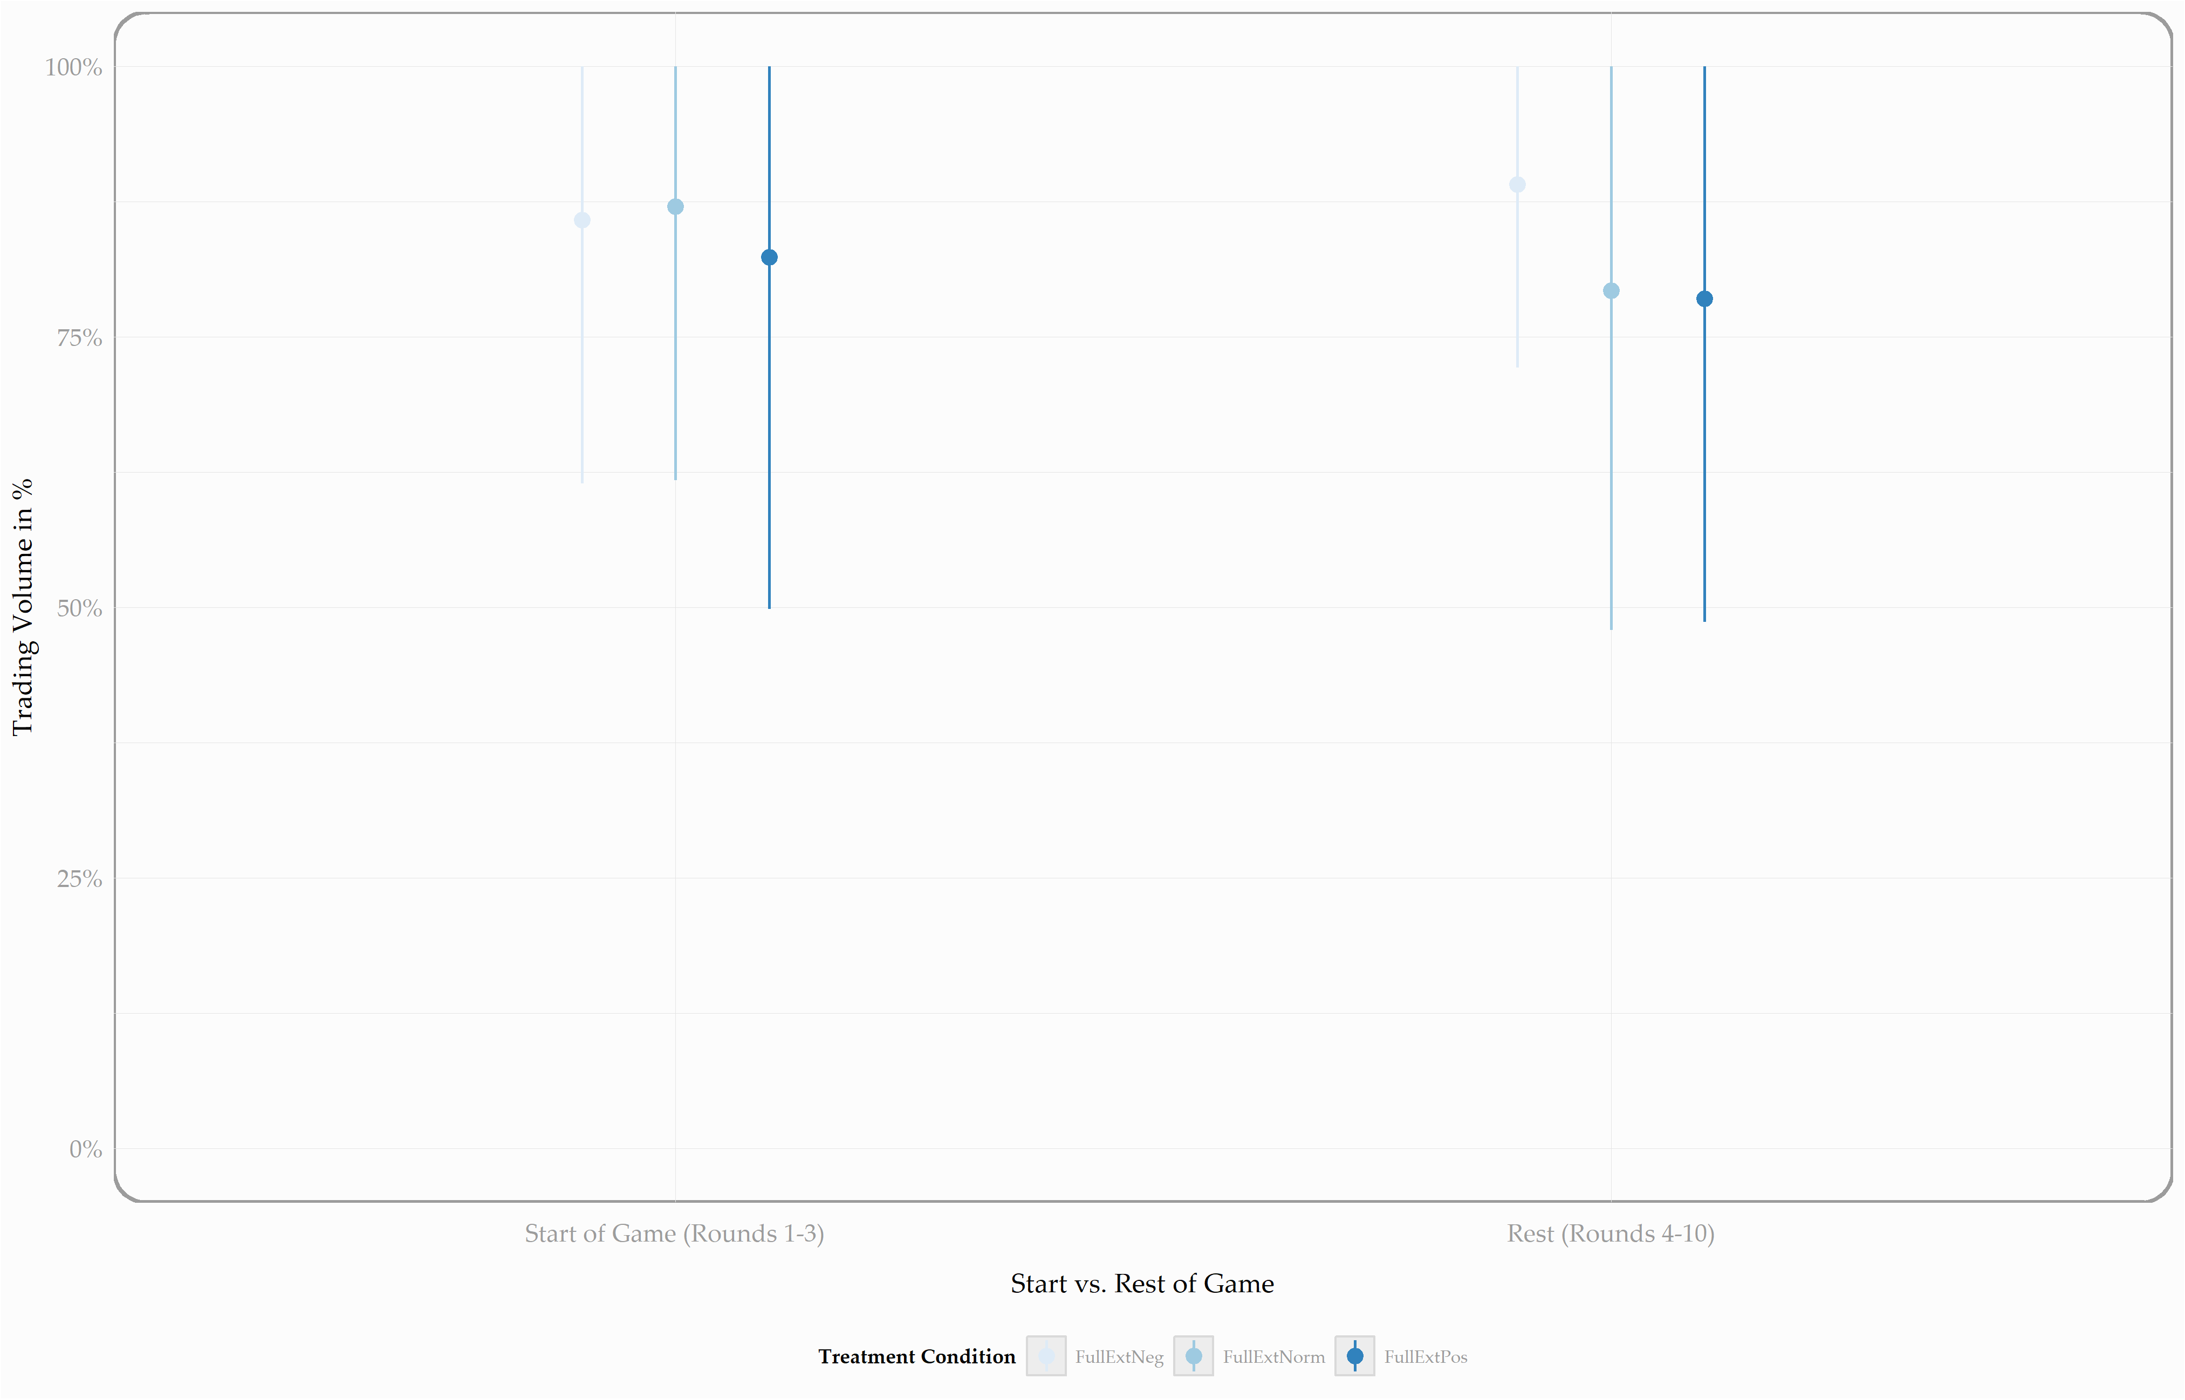

Slide 10
Macro Level Results – Gains of Trade
3
POLITICAL CORPORATE SOCIAL RESPONSIBILITY
ANALYSIS
Treatment | Observations* | Mean | Median | Std. | Direction | P-value**
Control | 50 | 83.02% | 82.98% | 12.92% | - | -
Neg. Externalities | 50 | 91.66% | 93.45% | 8.06% | Greater than | 0.00
Pos. Externalities | 60 | 85.97% | 87.50% | 13.97% | Greater than | 0.06
* Game treatment pairings ** Does the distribution significantly differ from the control group (depending on whether mean/median is higher or lower than the control group)?

Slide 11
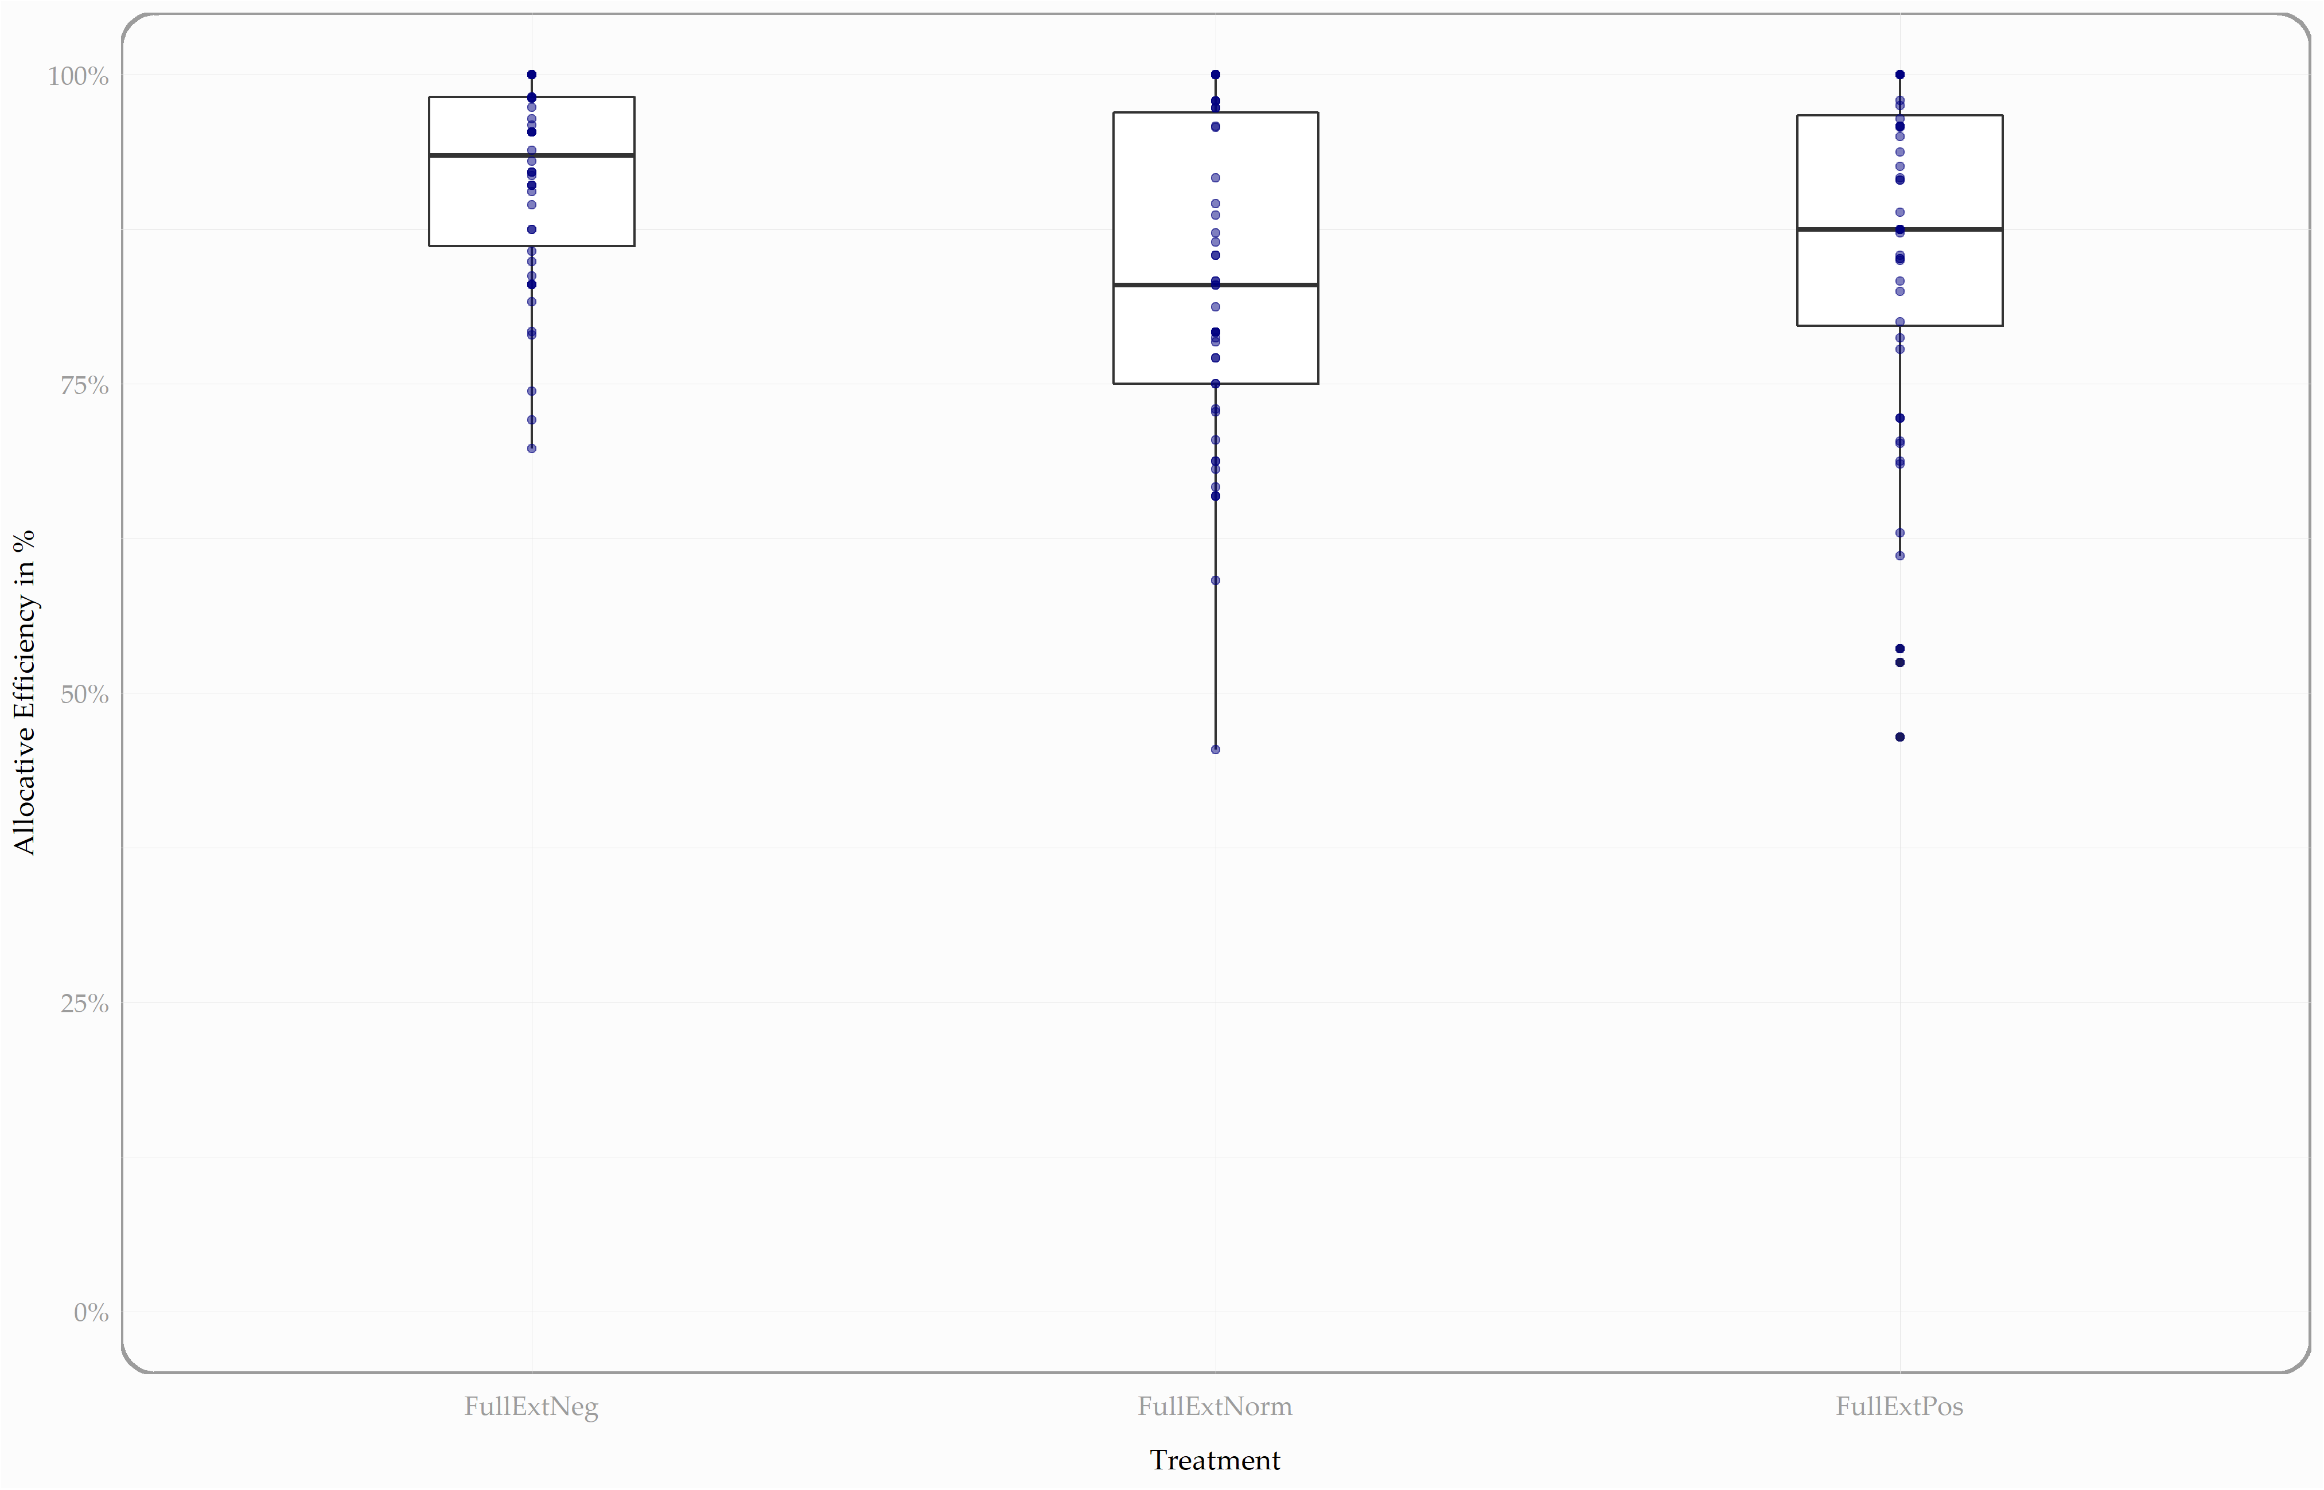

Slide 12
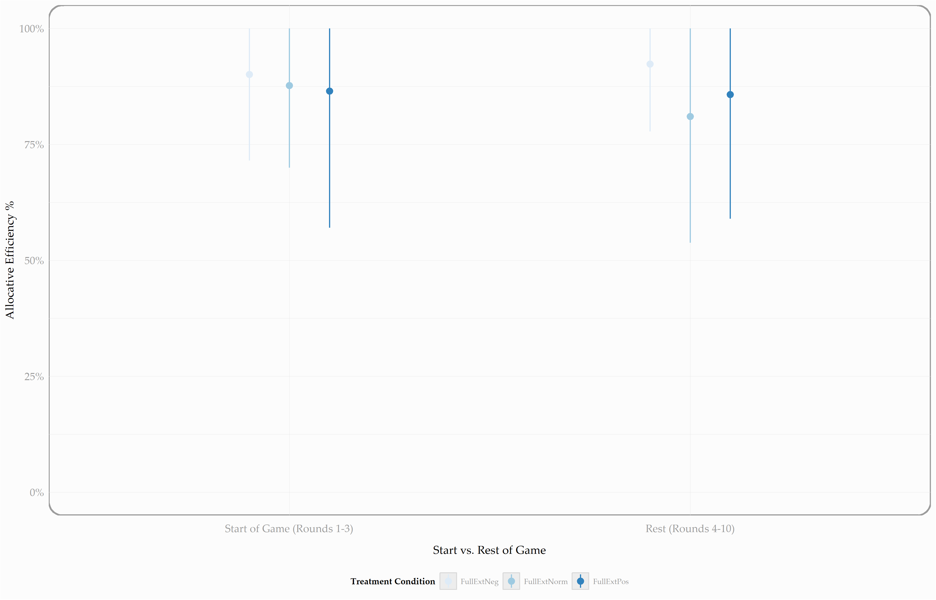

Slide 13
Macro Level Results – Price Volatility
3
POLITICAL CORPORATE SOCIAL RESPONSIBILITY
ANALYSIS
Treatment | Observations* | Mean | Median | Std. | Direction | P-value**
Control | 50 | 10.93 | 10.10 | 6.81 | - | -
Neg. Externalities | 50 | 12.14 | 9.03 | 7.31 | Greater than | 0.28
Pos. Externalities | 60 | 9.35 | 7.46 | 9.35 | Less than | 0.02
* Game treatment pairings ** Does the distribution significantly differ from the control group (depending on whether mean/median is higher or lower than the control group)?

Slide 14
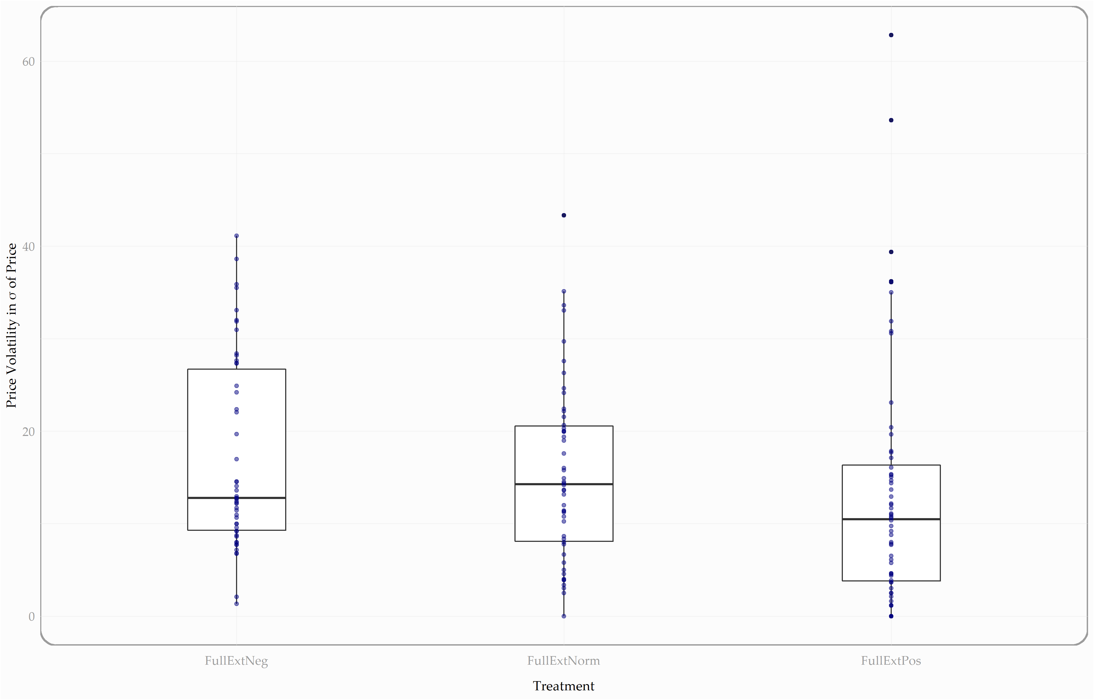

Slide 15
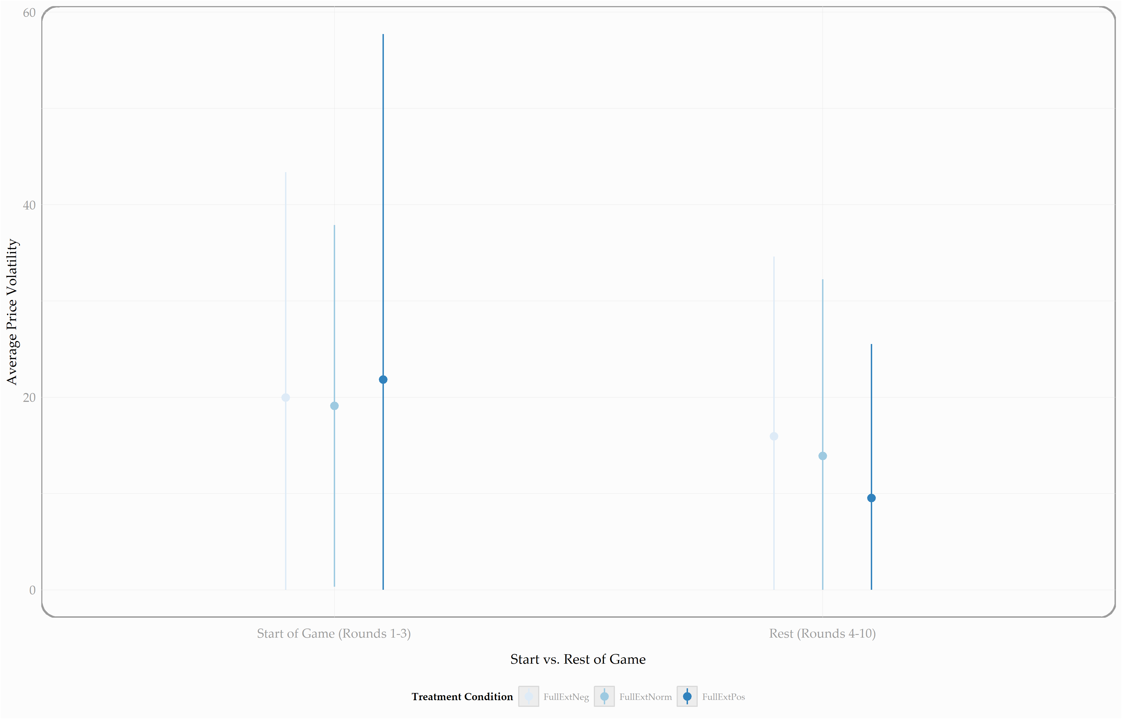

Slide 16
Macro Level Results – Price Levels
3
POLITICAL CORPORATE SOCIAL RESPONSIBILITY
ANALYSIS
Treatment | Observations* | Mean | Median | Std. | Direction | P-value**
Control | 50 | 100.80 | 100.60 | 7.18 | - | -
Neg. Externalities | 50 | 95.93 | 96.00 | 5.38 | Less than | 0.00
Pos. Externalities | 60 | 91.88 | 96.52 | 12.08 | Less than | 0.00
* Game treatment pairings ** Does the distribution significantly differ from the control group (depending on whether mean/median is higher or lower than the control group)?

Slide 17
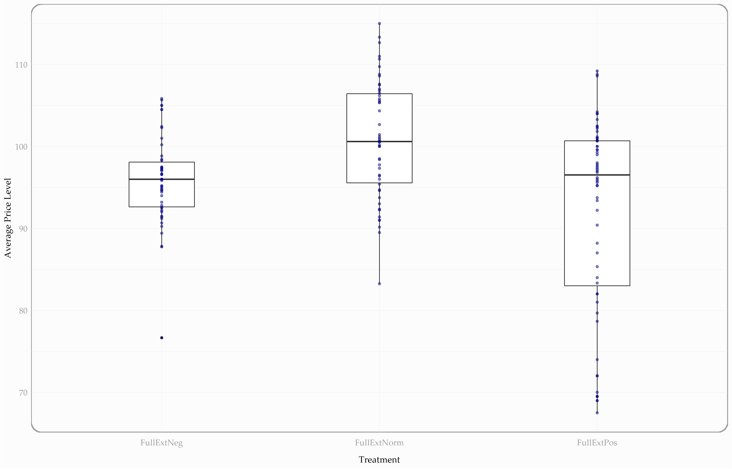

Slide 18
Micro Level Results – Buyers’ Aggressiveness
3
POLITICAL CORPORATE SOCIAL RESPONSIBILITY
ANALYSIS
Treatment | Observations* | Mean | Median | Std. | Direction | P-value**
Control | 323 | 33.44% | 25.20% | 27.23% | - | -
Neg. Externalities | 338 | 36.97% | 31.16% | 25.34% | Greater than | 0.00
Pos. Externalities | 305 | 35.03% | 29.69% | 24.52% | Greater than | 0.03
* Active participants unique per treatment, game, and round ** Does the distribution significantly differ from the control group (depending on whether mean/median is higher or lower than the control group)?

Slide 19
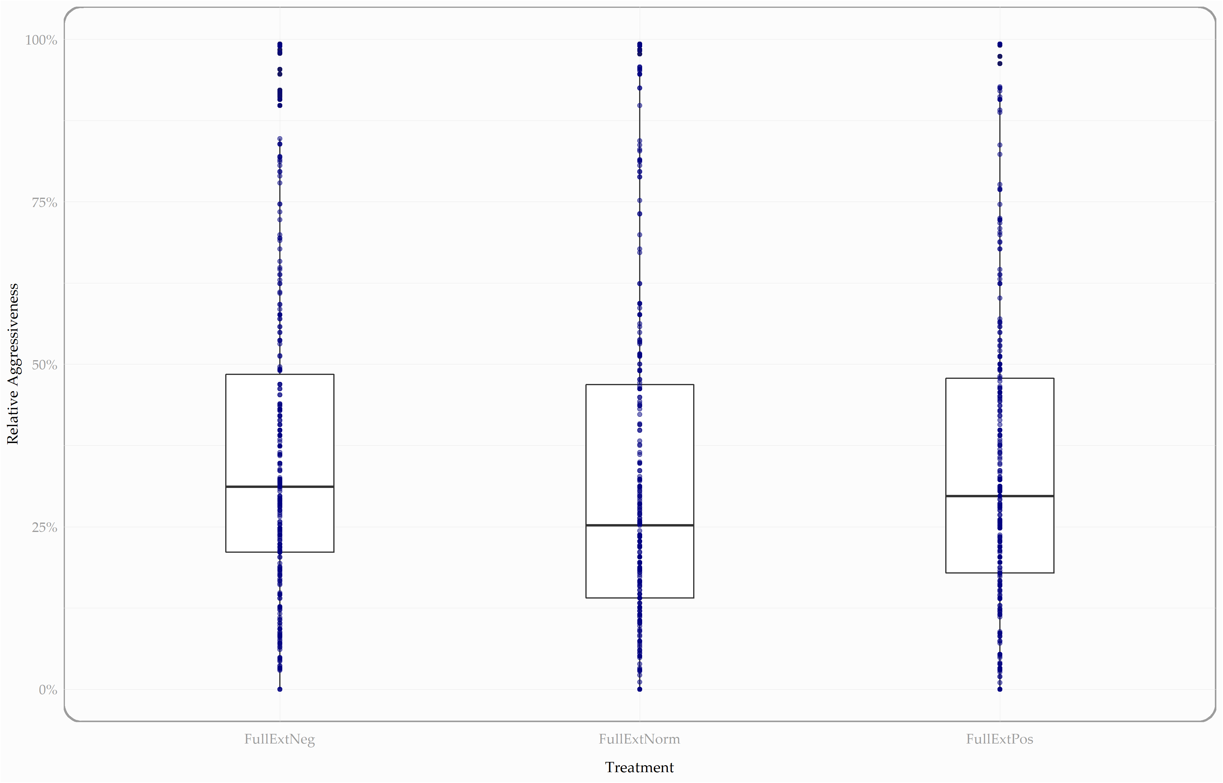

Slide 20
Micro Level Results – Sellers’ Aggressiveness
3
POLITICAL CORPORATE SOCIAL RESPONSIBILITY
ANALYSIS
Treatment | Observations* | Mean | Median | Std. | Direction | P-value**
Control | 278 | 118.69% | 39.71% | 235.71% | - | -
Neg. Externalities | 401 | 61.35% | 32.05% | 106.42% | Less than | 0.04
Pos. Externalities | 345 | 68.83% | 34.94% | 132.21% | Less than | 0.01
* Active participants unique per treatment, game, and round ** Does the distribution significantly differ from the control group (depending on whether mean/median is higher or lower than the control group)?

Slide 21
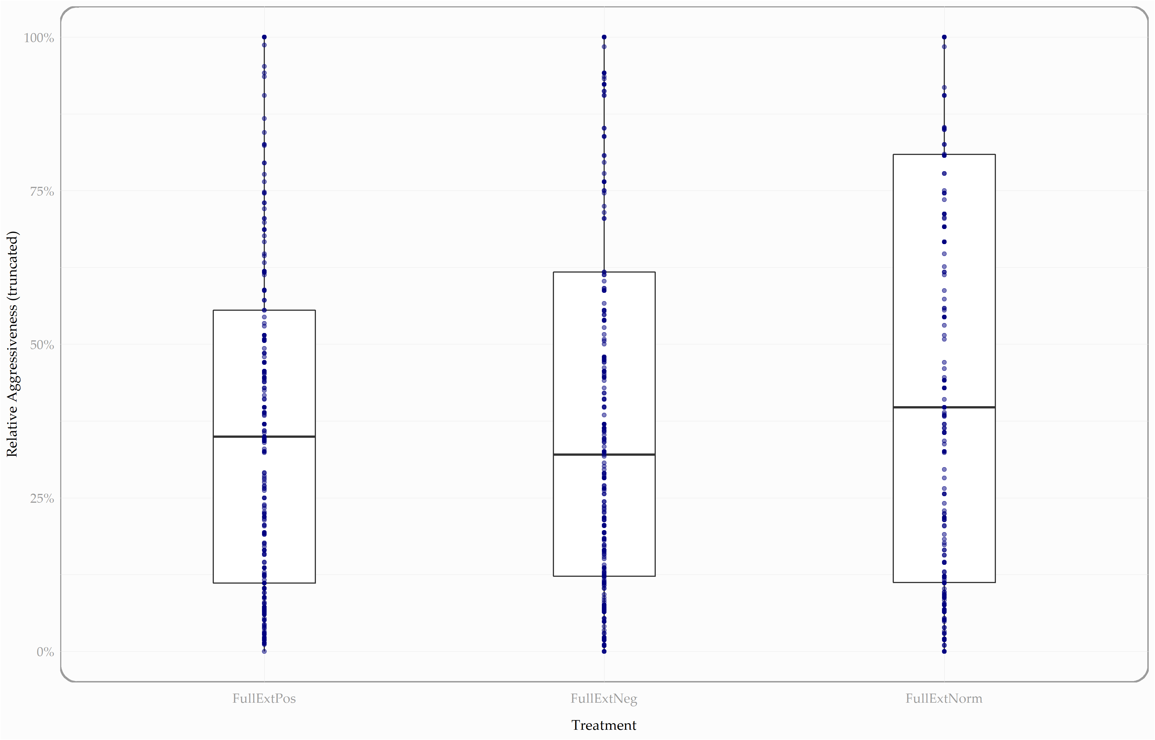
Notes:
When aggressiveness is higher than 1 (i.e. 100%), then I substitute whatever the number is with 1. Like this, I set a limit to the aggressiveness without just filtering out valuable information.

Slide 22
Main Take-Aways
1
POLITICAL CORPORATE SOCIAL RESPONSIBILITY
SUMMARY & POLICY RECOMMENDATIONS
Market Efficiency
Price Volatility
Price Levels
Rel. Aggressiveness
First
Then
First
Then
Overall
Buyers
Sellers
Externalities definitely influence market behavior – even without (government) interference! Instead, existing value systems (like norms!) guide behavior under these treatment conditions. Therefore, studying and understanding how norms emerge and proliferate becomes imperative when designing markets with externalities.

Slide 23
References
Baron, D. P. (2001). Private politics, corporate social responsibility, and integrated strategy. Journal of Economics and Management Strategy, 10(1), 7–45. https://doi.org/10.1162/105864001300122548
Kitzmueller, M., & Shimshack, J. (2012). Economic perspectives on corporate social responsibility. Journal of Economic Literature, 50(1), 51–84. https://doi.org/10.1257/jel.50.1.51
Goodley, Simon (2013, February 17). Death, sanctions and big business in the struggle for Zimbabwe’s diamonds. The Guardian. https://www.theguardian.com/business/2013/feb/17/zimbabwe-death-sanctions-business-diamonds [accessed on October 25].
Chevron fined for Amazon pollution by Ecuadorian court (2011, February 11). BBC. https://www.bbc.com/news/world-latin-america-12460333 [accessed on October 25].
Goodley, Simon (2015, June 21). Compass Group subsidiary ‘paid bribes to Kazakhstan customs officials’. The Guardian. https://www.theguardian.com/business/2015/jun/21/compass-group-subsidiary-paid-bribes-to-kazakhstan-customs-officials [accessed on October 25].
Benabou, R., & Tirole, J. (2010). Individual and corporate social responsibility. Economica, 77(305), 1–19. https://doi.org/10.1111/j.1468-0335.2009.00843.x
Frynas, J. G., & Stephens, S. (2015). Political Corporate Social Responsibility: Reviewing Theories and Setting New Agendas. International Journal of Management Reviews, 17(4), 483–509. https://doi.org/10.1111/ijmr.12049

